Slide 1

How do Organisms
Reproduce?
Introduction to sexual reproduction and its importance

Slide 2






Asexual
Sexual
Two parents involved
Dogs, Human, Plants, Birds

Slide 3


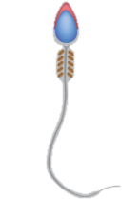


Sexual reproduction
Two parents are involved
and the other female
One male
Female gamete
Male gamete
The male and female gamete fuse together to form unicellular zygote
Larger, contains stored food
Germ cells / gametes
Smaller, motile
Reproductive cells
zygote

Slide 4

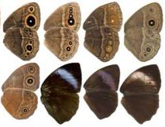
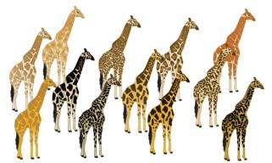
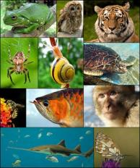
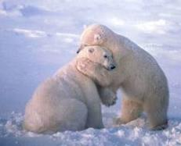
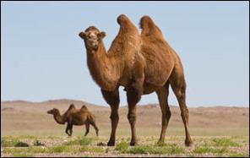
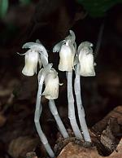

Importance of sexual reproduction
Since there is fusion of two germ cells from two different individuals, variations are produced.
Variations give rise to variety and diversity.
It enables organisms to adapt and surive in the changing environment.
It helps to prevent the complete extinction of animal and plant species.

Slide 5
Thank You

